Slide 1
Variational Autoencoders

Slide 2
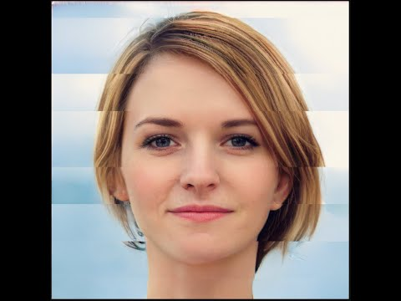
https://www.youtube.com/watch?v=4dqemVV5e6M

Slide 3
Agenda
Autoencoder movie
Discussion
Variational autoencoder (VAE) movie
Discussion
Recent publications on VAEs
Special guest
Games!

Slide 4
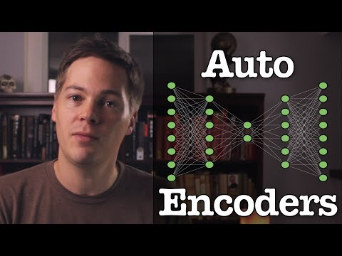

Slide 5
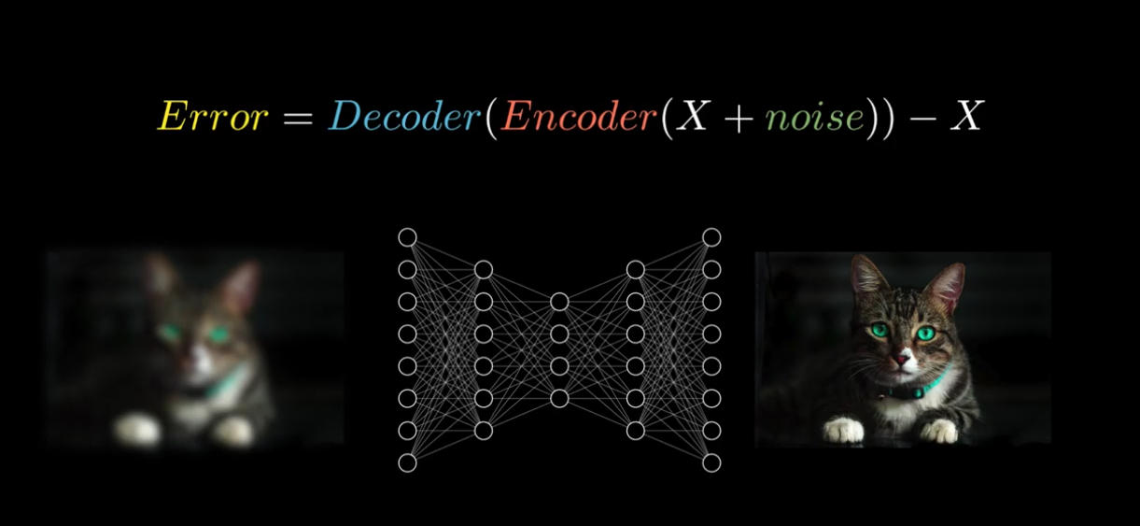
Autoencoders discussion

Slide 6
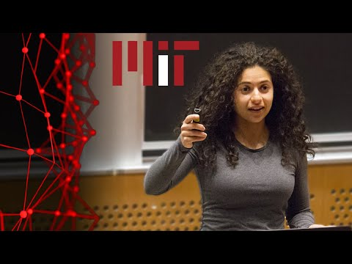

Slide 7
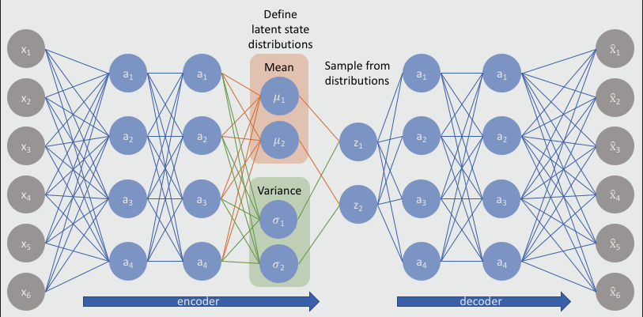
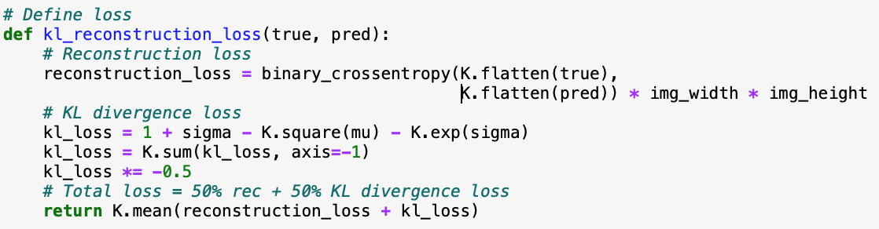
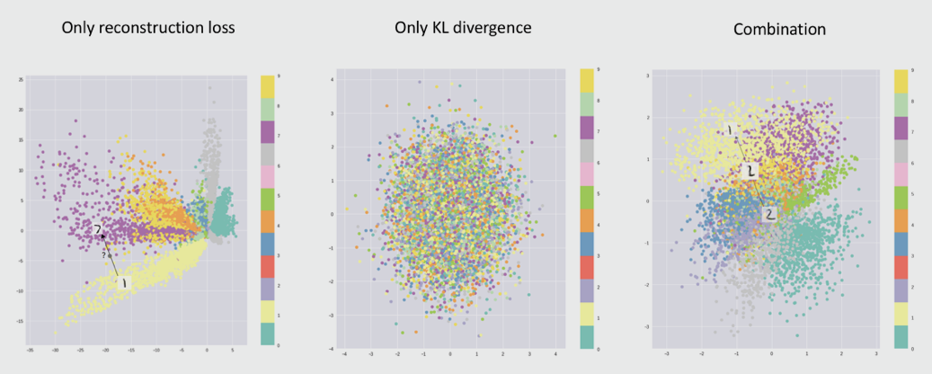
Variational autoencoders discussion
From: https://www.jeremyjordan.me/variational-autoencoders/

Slide 8
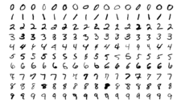
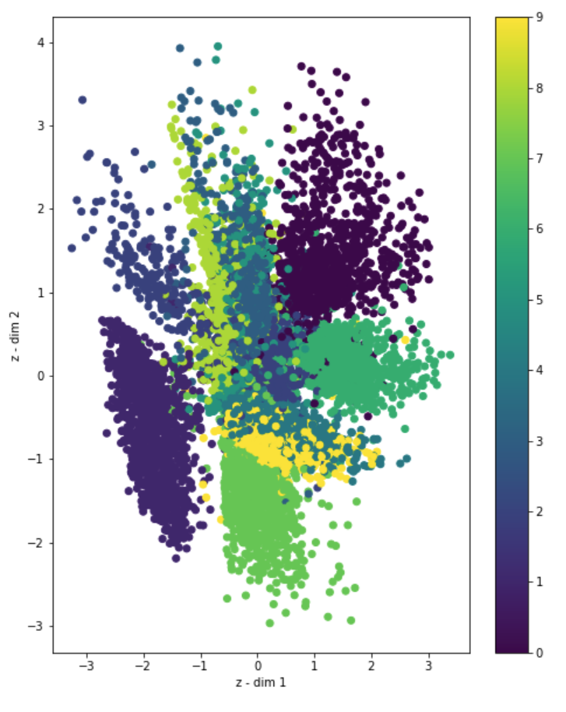
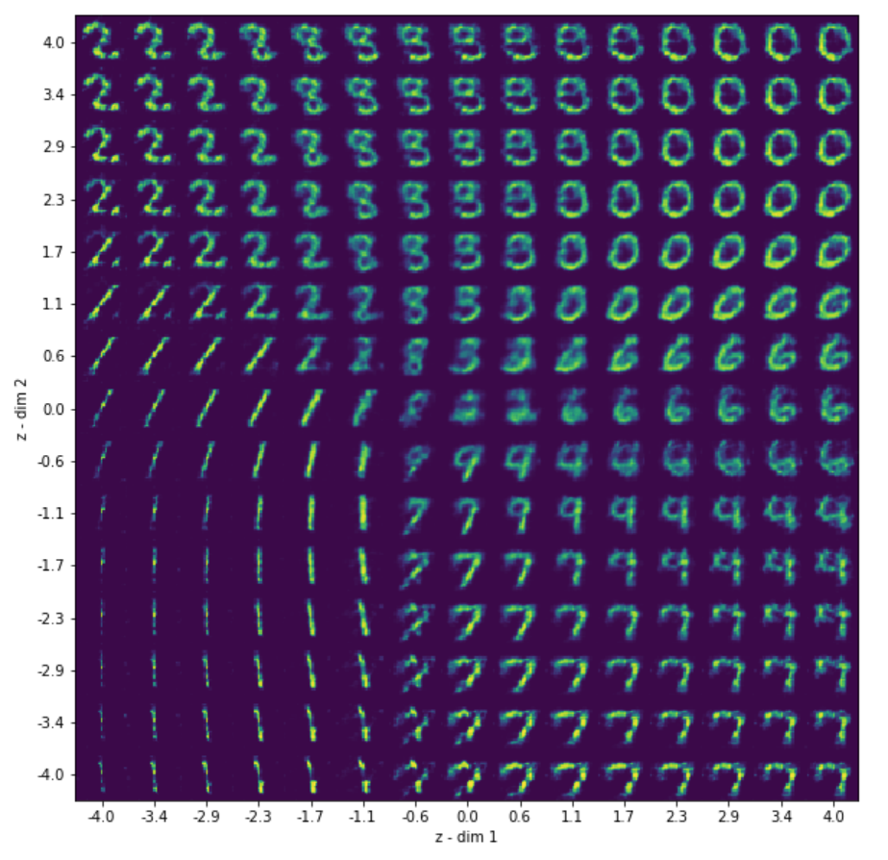

Slide 9
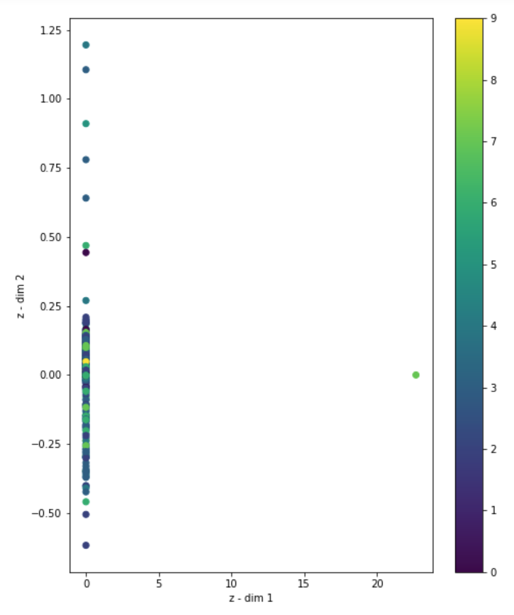
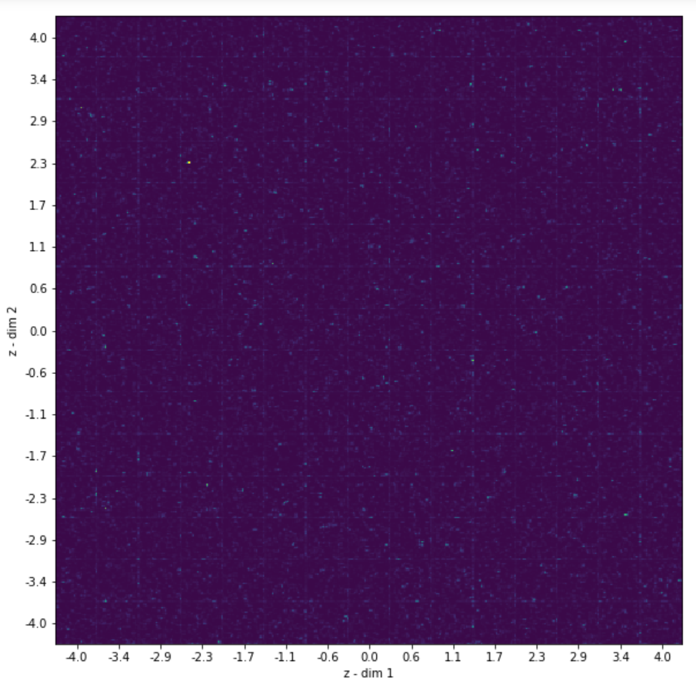

Slide 10
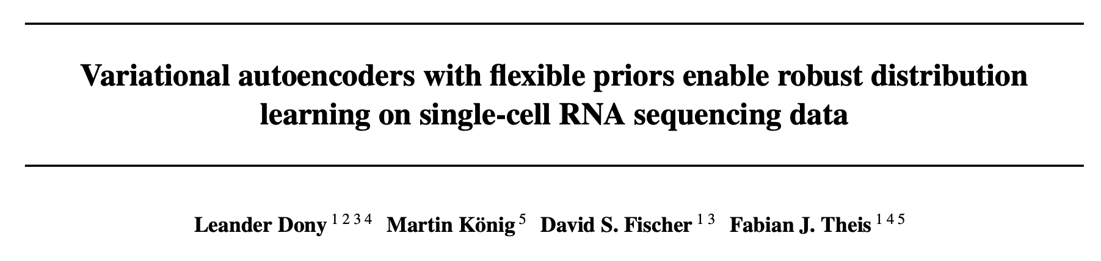

Slide 11
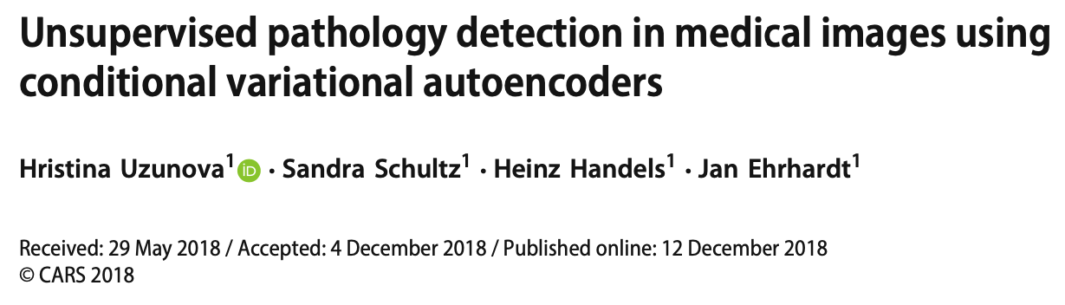
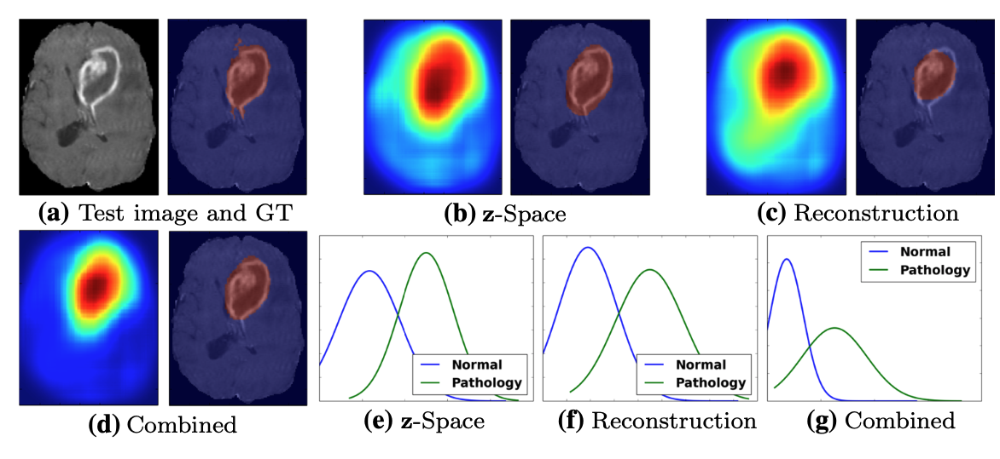
1st approach:
The cVAE learns to map healthy tissue to a normal distribution while training
In the test phase healthy patches would also get mapped to the same normal distribution per condition
Pathological patches on the same relative positions, however, differ from healthy tissue drastically, which leads to the assumption that their latent representations are very different to the ones of the healthy patches and lie far outside the normal distribution
Thus, the distance from a z-vector of a pathological patch to the mean of the normal distribution of the healthy training data is large (figure b)
2nd approach:
Another possibility is that by only learning to reconstruct healthy patches the autoencoder reconstructs pathological patches poorly or tries to interpret them as healthy.
Hence, big distances between the input image and the reconstruction would occur in the area of the pathology (figure c).
“Learn a reasonable representation of the healthy tissue variability so that pathological tissue can be detected as a major difference to the learned representation

Slide 12
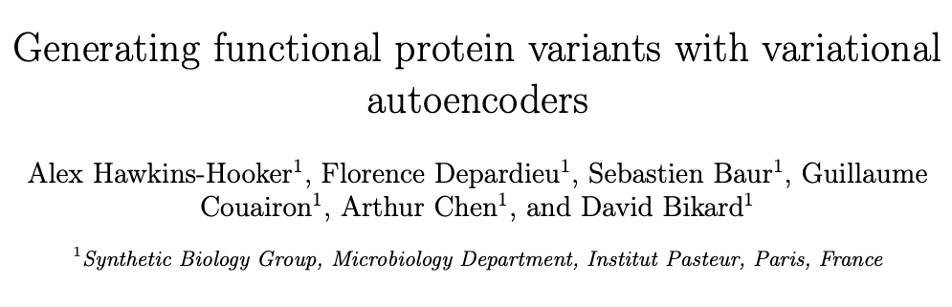
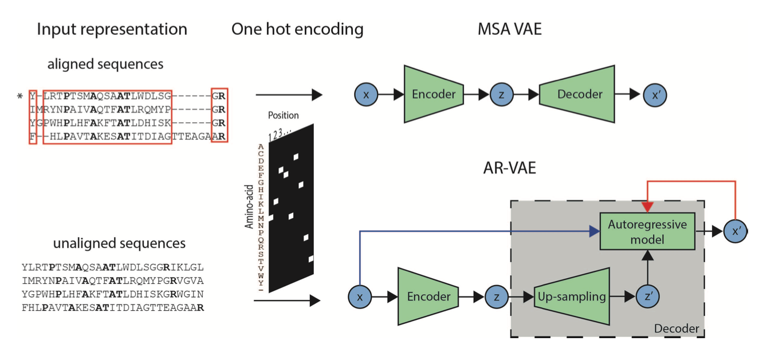
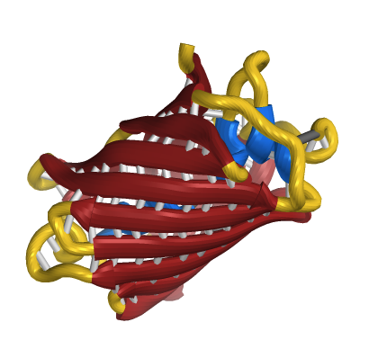
“We have developed variational autoencoder models capable of generating novel functional variants of a luminescent protein when trained on a set of homologues of the target.”
“Experimental validation confirmed that a significant fraction of variants of a target luxA protein generated by both models were functional”

